Slide 1




Leaves
The need to access
Approvals

Slide 2



Slide 3
The time
allotted
in manual
monitoring
& tracking?

Slide 4

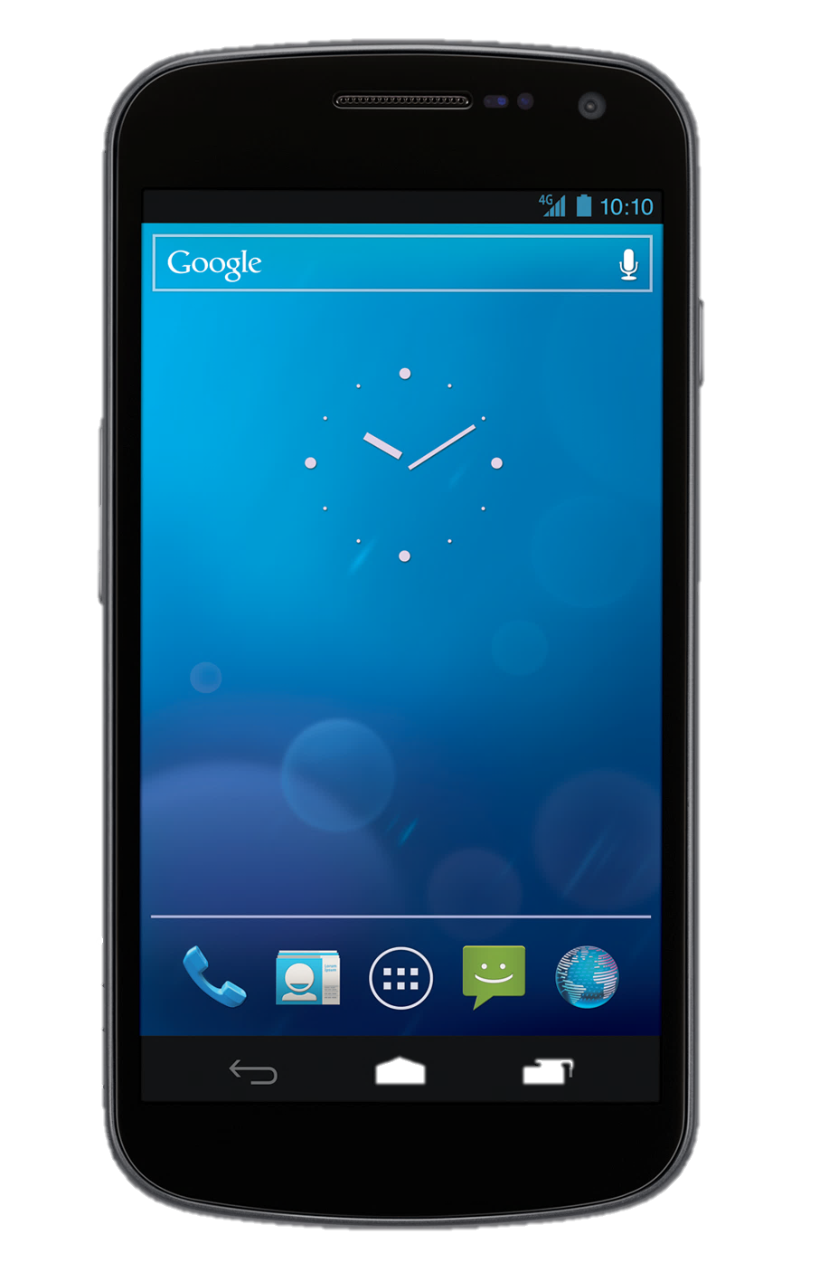
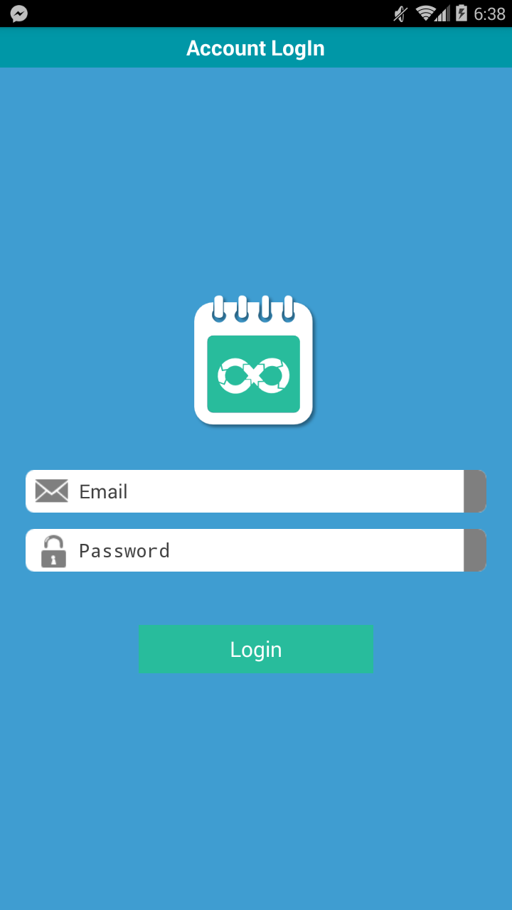
Imagine
an
easier
and
faster
way

Slide 5

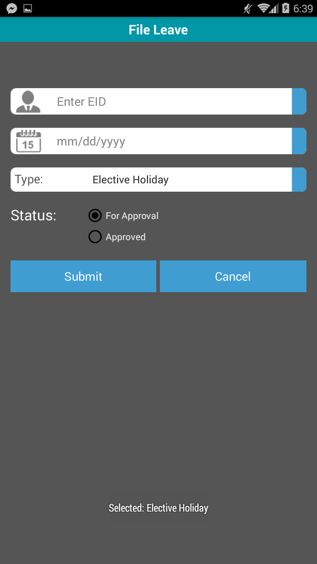
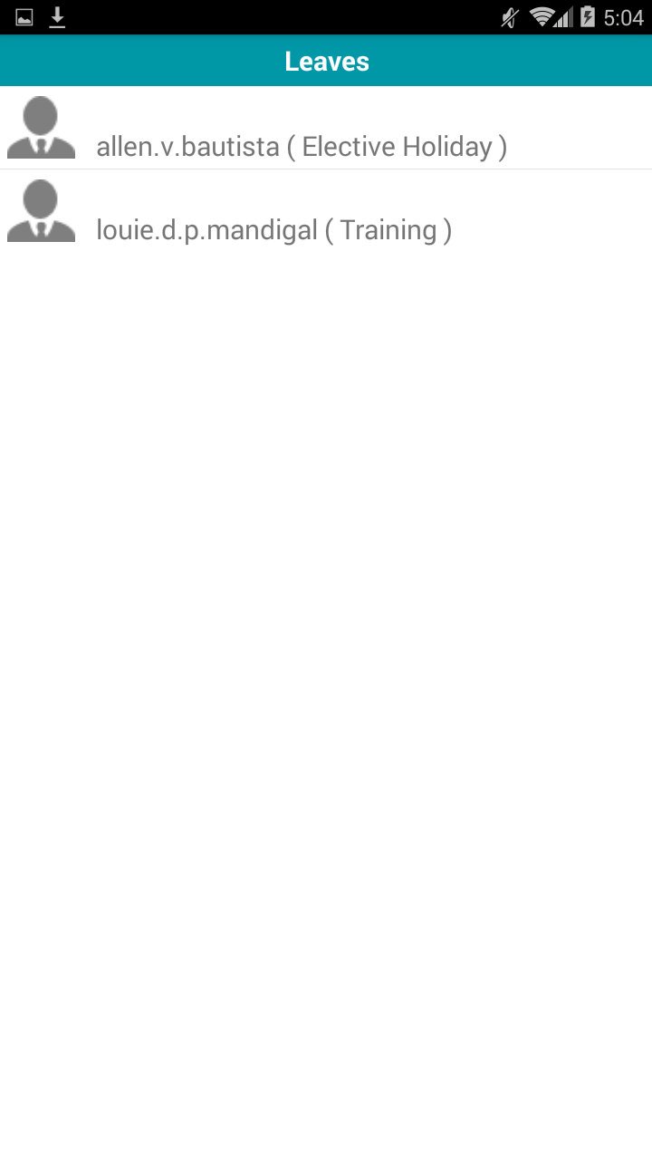
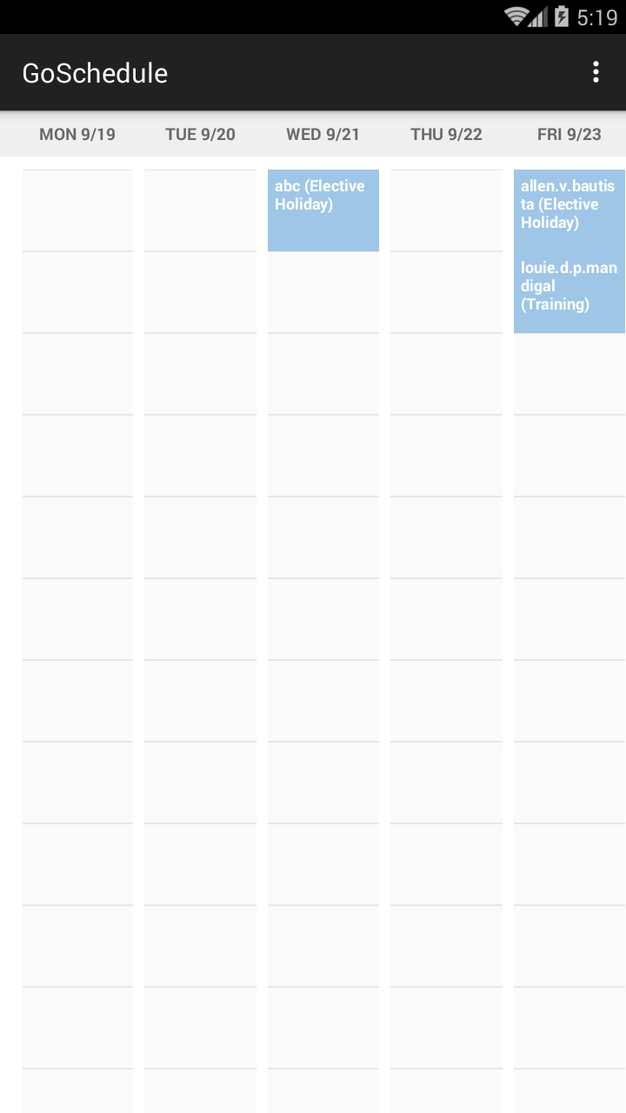
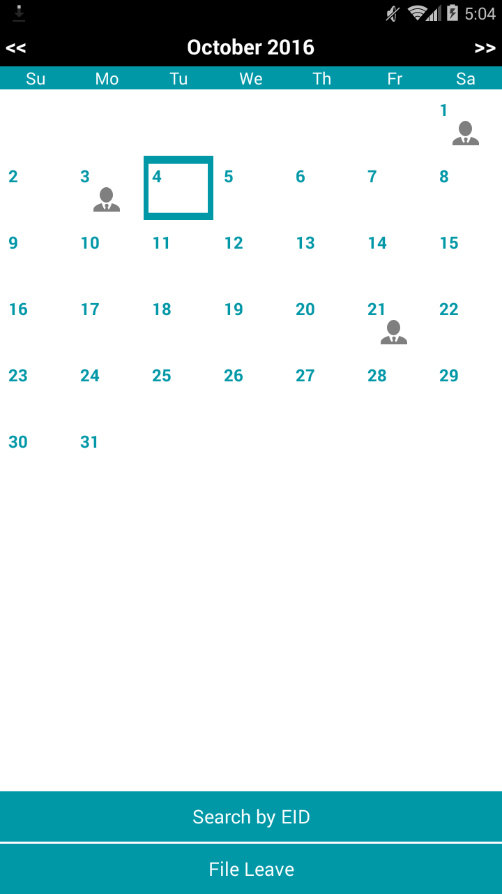

Reduce Manual Intervention
Delivered straight to your hand by
Go Schedule Android App
For more inquiries, please contact:
Real Time Updates
A mobile app which innovates the process of logging and approving of leaves, bringing it straight to your smart phones.
Access Anywhere
DEVOPS CAPABILITY
PDC.DevOps.Support@accenture.com
Generate Reports

Slide 6
Reduce Manual Intervention
Go Schedule Android App
Real Time Updates
A mobile app which innovates the process of logging and approving of leaves, bringing it straight to your smart phones.
Access Anywhere
Generate Reports

